Slide 1


Application for Vaccine Registration
Course Number: 44618-02

Slide 2
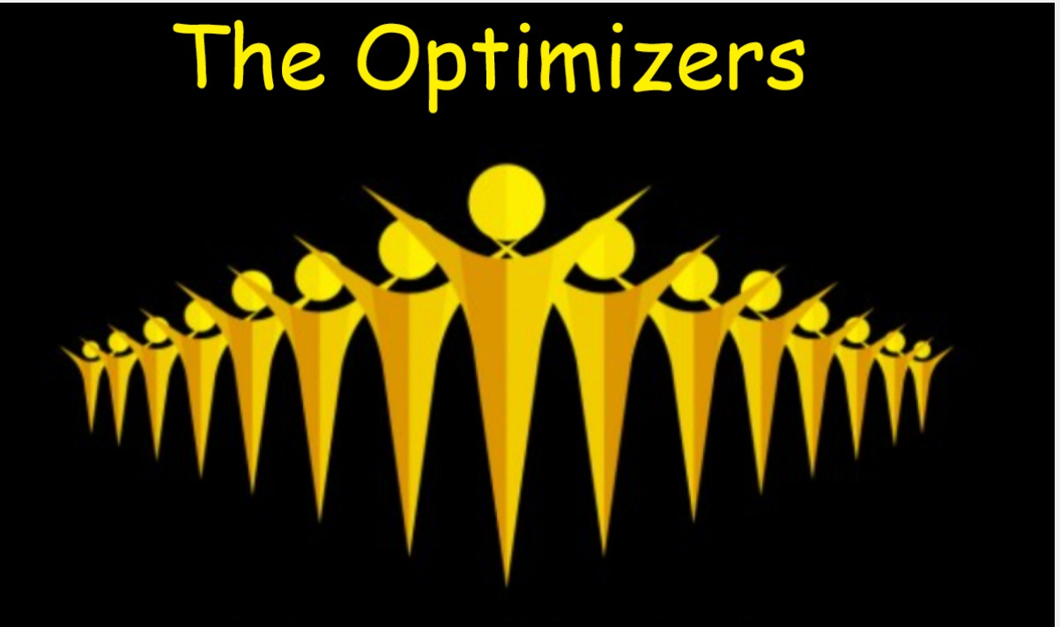
TEAM NAME – The Optimizers
PRESENTERS
Bala Shankar Malladi – Project Manager
Swetha Gahana Sanagala – Project Lead
Swarupa Pedapalli - Developer
Vivek Drakshapalli - Developer
Venkat Jarugula- Developer

Slide 3
Problem Statement:
This project is to develop a user-friendly web-application, which allows the public to check the available slots to get vaccinated and to get register on the required date and application also allows the hospital to check the data of people who registered for the vaccination and their health history.

Slide 4
Requirements:
Business Requirements:
This application should allow public to check the available slots to get vaccinated and to get register on the required date by using this web application.
This application also allows the hospital to check the data of people who registered for the vaccination and their health history.
Technical Requirements:
Programming languages used: Java, typescript
Frontend technologies: Html, CSS, Bootstrap5 and Angular8
IDE: Eclipse, Visual Studio Code
Database: MySql
Testing tools: PostMan (For testing rest end points)

Slide 5
Project Management Plan
Project Integration Management
Project Scope Management
Project Schedule Management
Project Cost Management
Project Quality Management
Project Resource Management
Project Communications Management
Project Risk Management
Project Procurement Management
Project Stakeholder Management

Slide 6
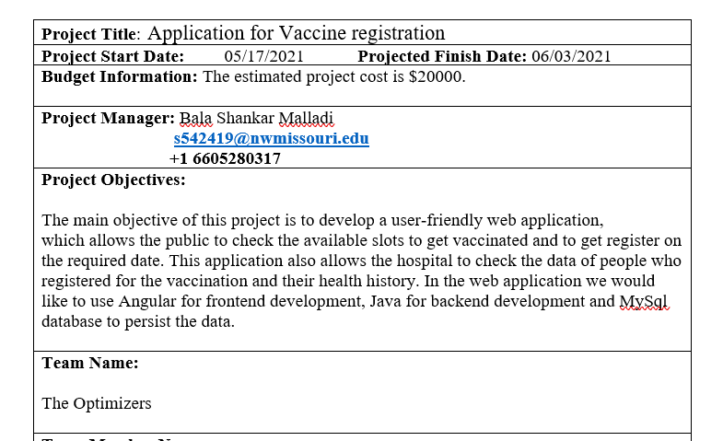
Project Integration Management
Project Integration:
Includes the processes and activities to identify, define, combine, unify, and coordinate the various processes and project management activities within the Project Management Process Groups.
Processes:
Developing the project charter
Developing the project management plan
Directing and managing project work
Monitoring and controlling project work
Performing integrated change control
Closing the project or phase

Slide 7
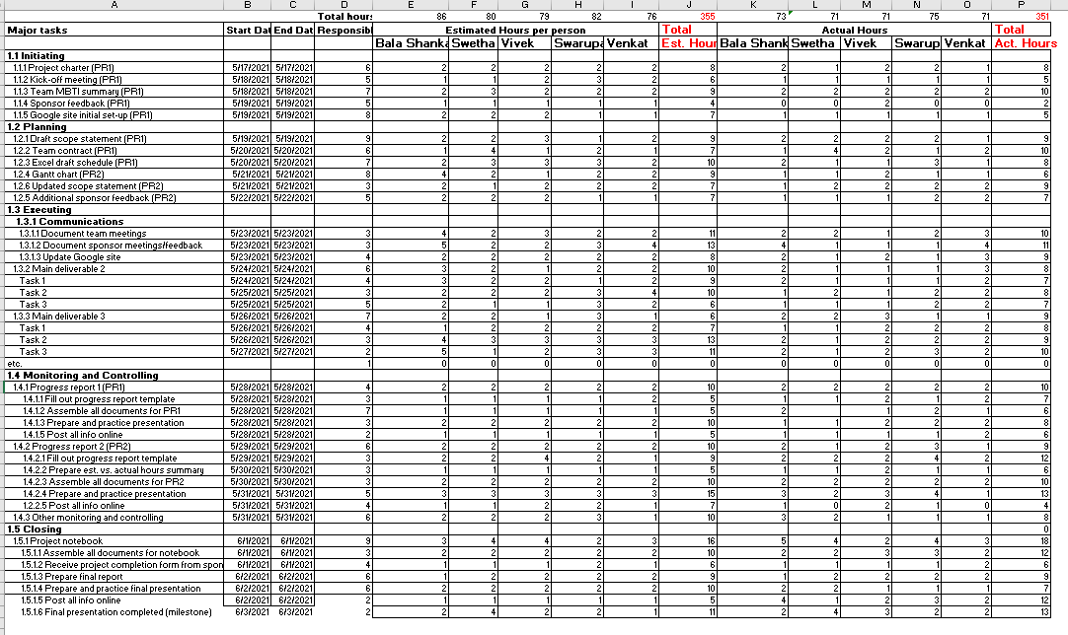
Project Scope Management
Scope is defined as boundaries of a task or project.
Planning scope management
Collecting requirements
Defining scope
Creating the WBS
Validating scope
Controlling scope

Slide 8
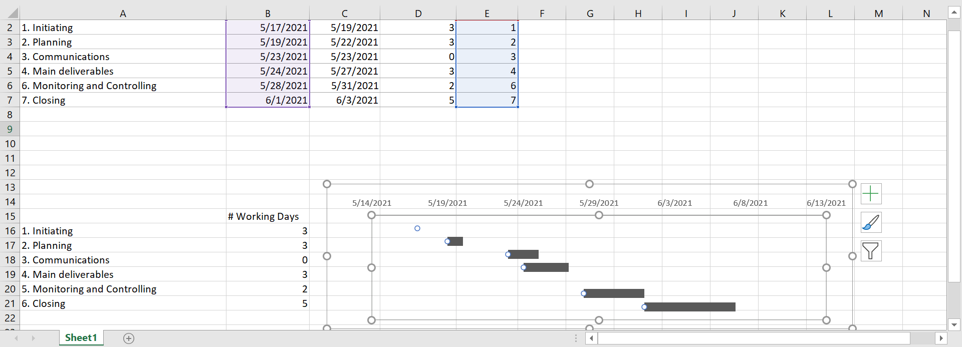
Project Schedule Management
Planning schedule management
Defining Activities
Sequencing activities
Estimating activity resources
Estimating activity durations
Developing the schedule
Controlling the schedule

Slide 9
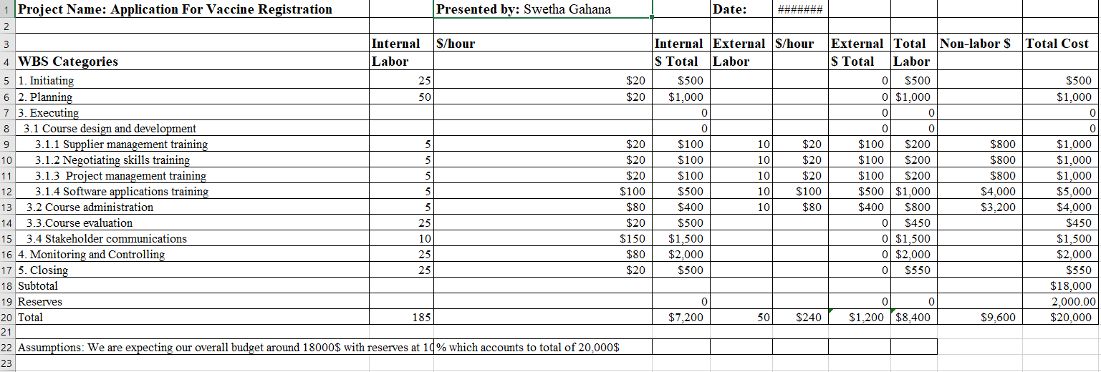
Project Cost Management
Project Cost Management is a method that uses technology to measure cost and productivity through the full life cycle of enterprise level projects
Project Cost Management processes:4 procs
Planning cost management
Estimating costs
Determining the budget
Controlling costs

Slide 10
Project Quality Management
Project quality management ensures the project will satisfy the needs for which it was undertaken
Planning quality management
Managing quality
Controlling quality
In order to ensure proper quality is maintained in the project we have done the following Activities:
Unit Testing, Integrating testing, System testing and User acceptance testing.
All the above mentioned tests are done, So that user don’t face any issues accessing the web application .For example, giving proper feedback if the user enter the invalid data.
Quality audits are done frequently and any rework identified can be implemented in the upcoming sprints

Slide 11
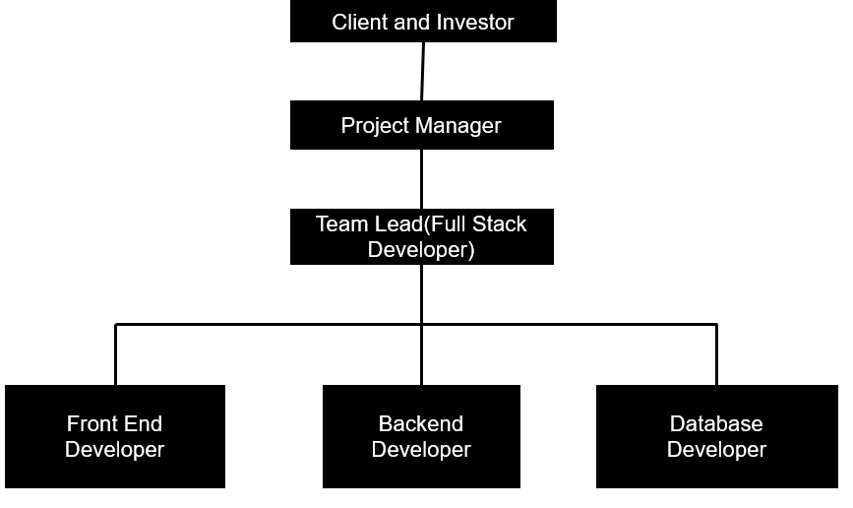
Project Resource Management
Project resource management includes the processes required to make the most effective use of the people involved with a project
Planning resources
Estimating activity resources
Acquiring resources
Developing the team
Managing the team
Controlling resources

Slide 12

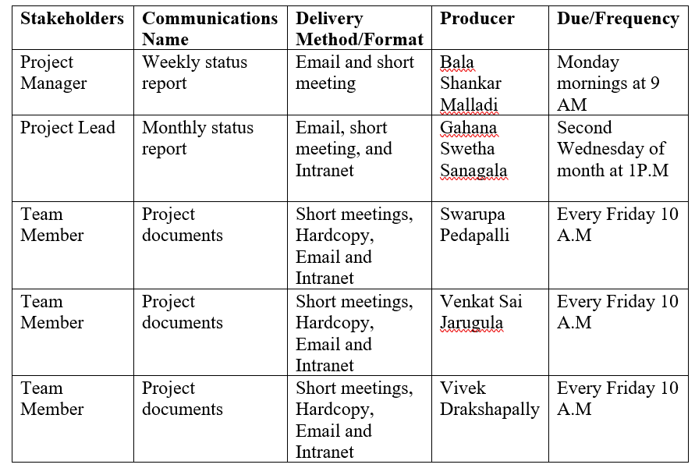



Project Communication Management
1.Planning Communication Management
2.Managing Communication
3.Monitoring communication

Slide 13
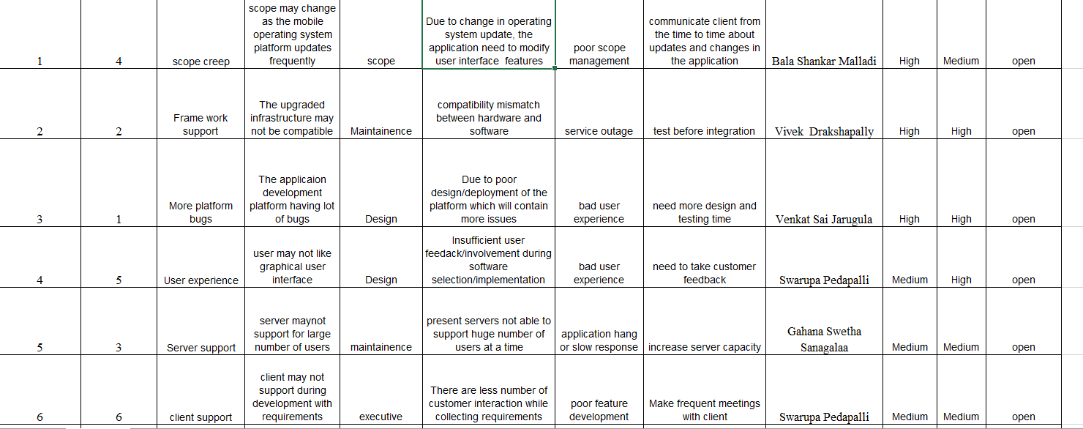
Risk Management
The goal of project risk management is to minimize potential negative risks while maximizing potential positive risks.
Risk Management processes:
Planning risk management
Identifying risks
Performing qualitative risk analysis
Performing quantitative risk analysis
Planning risk responses
Controlling risk

Slide 14
Project Procurement Management
Project Procurement Management means acquiring goods and services for a project from outside the performing organization.
Planning procurement management
Conducting procurements
Controlling procurements

Slide 15
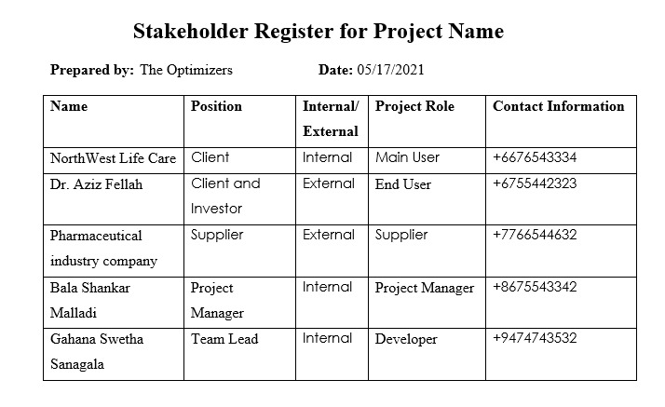
Project Stakeholder Management
Project stakeholder management
processes
Identifying stakeholders
Planning stakeholder management
Managing stakeholder engagement
Monitoring stakeholder
engagement

Slide 16
Conclusion
The project we taken was devolping an application for vaccine registration. It is an application where hospital management can view the registered candidates who taken part in the registration. Contemporarily hospital management can also send the error message if the user enters invalid credentials.
We were able to complete our project on schedule and in the most efficient manner by utilizing all 10 knowledge Areas and Five process groups to develop the application.

